Slide 1
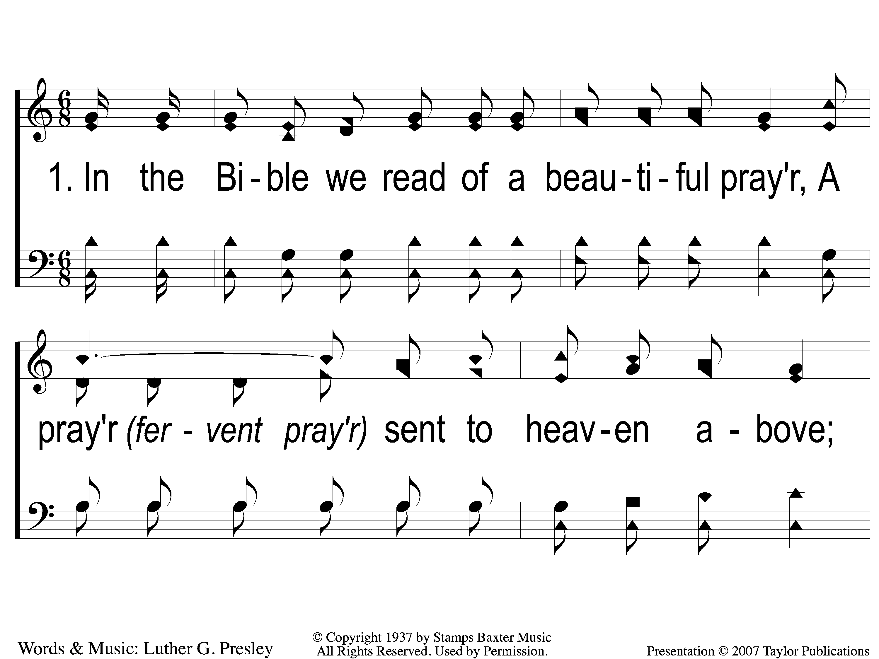
1-1 A Beautiful Prayer
A Beautiful Prayer
11

Slide 2
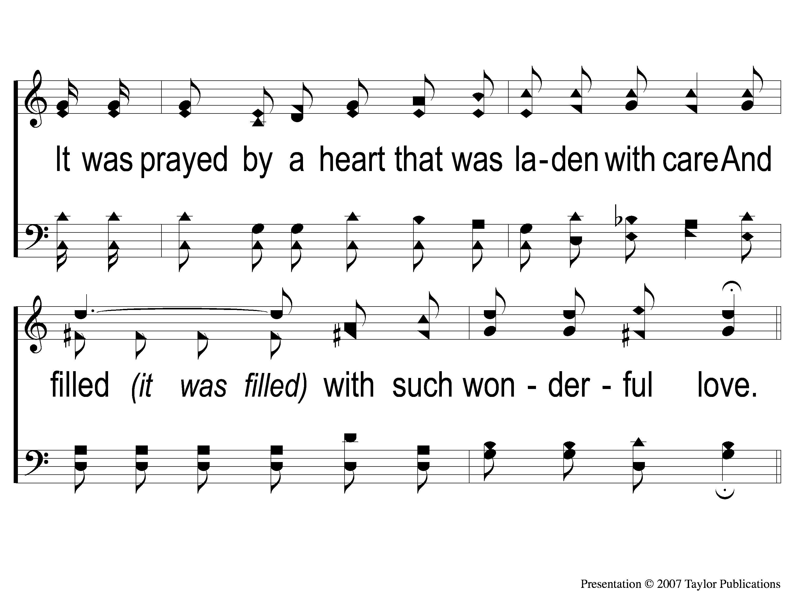
1-2 A Beautiful Prayer
A Beautiful Prayer
11

Slide 3
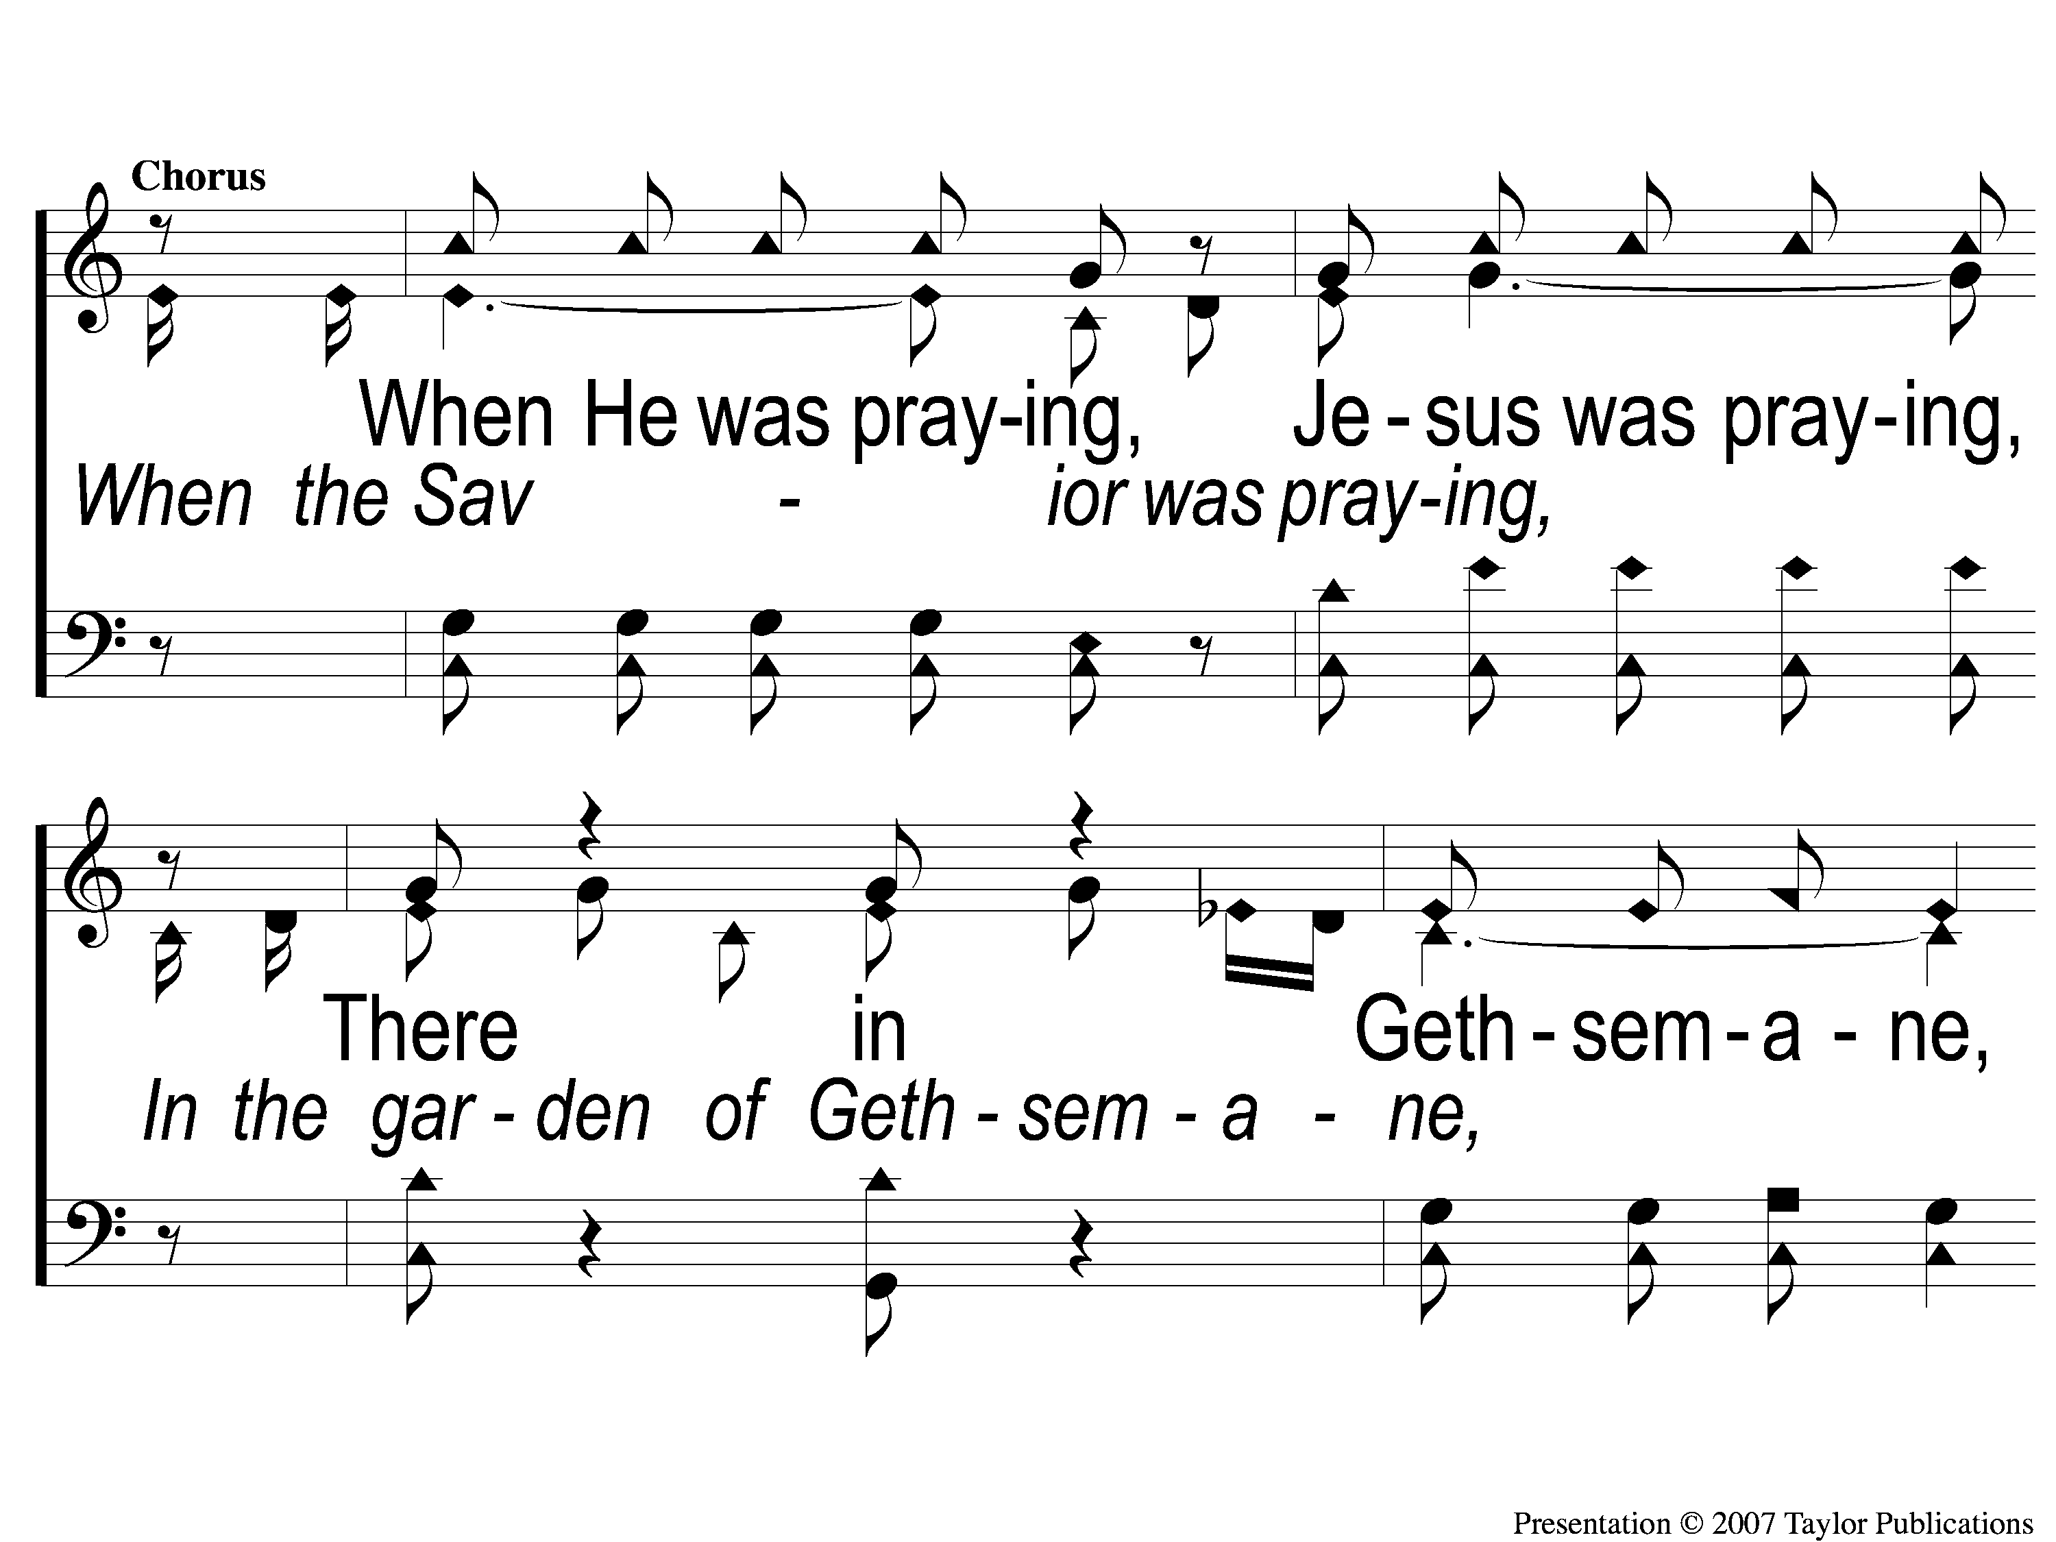
C-1 A Beautiful Prayer
A Beautiful Prayer
11

Slide 4
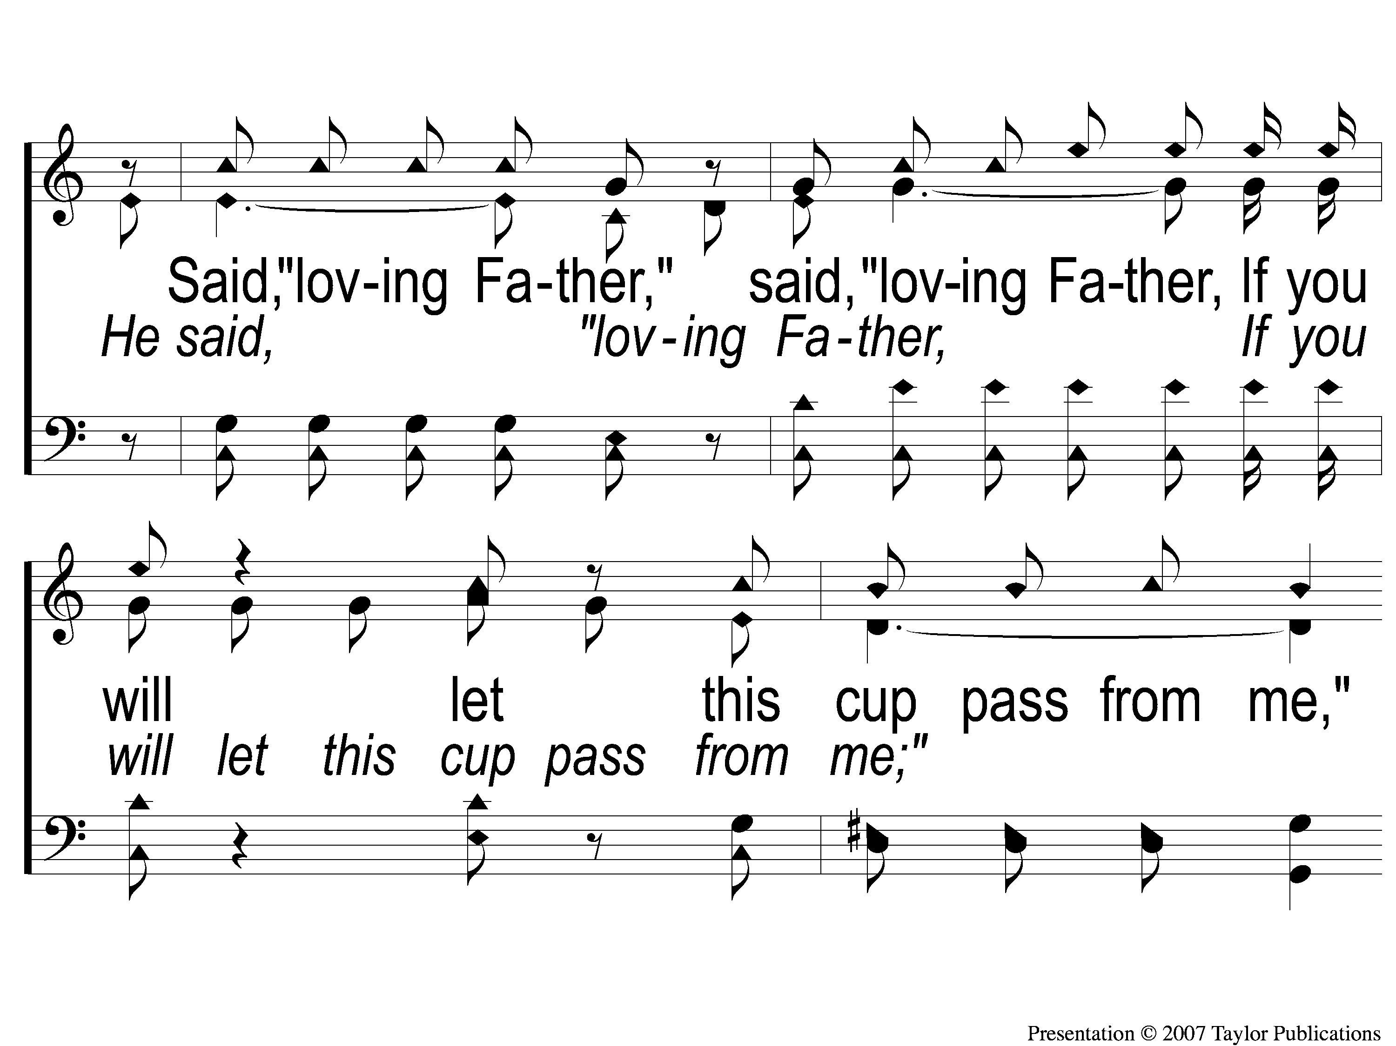
C-2 A Beautiful Prayer
A Beautiful Prayer
11

Slide 5
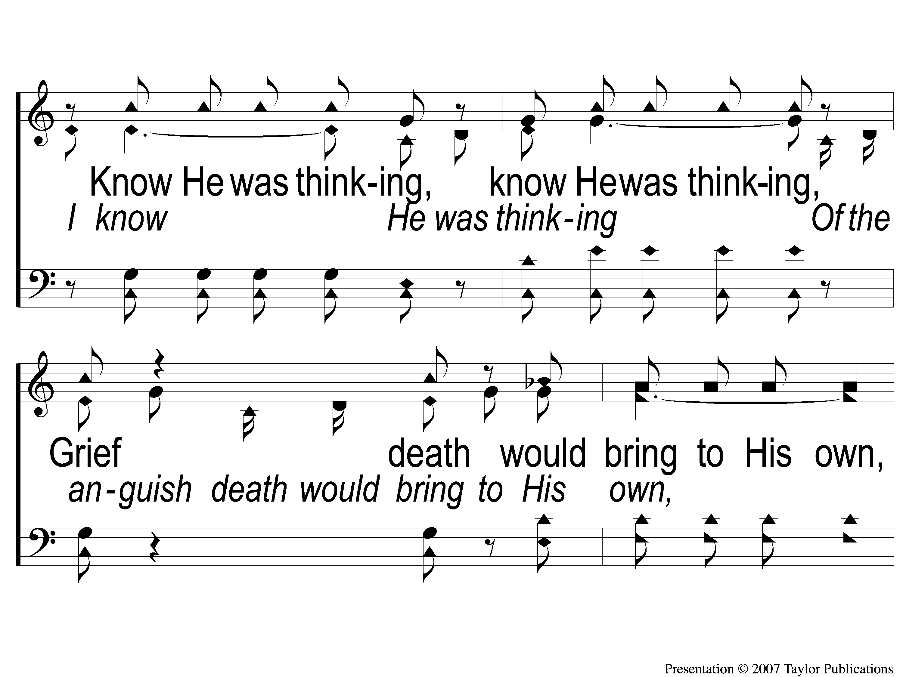
C-3 A Beautiful Prayer
A Beautiful Prayer
11

Slide 6
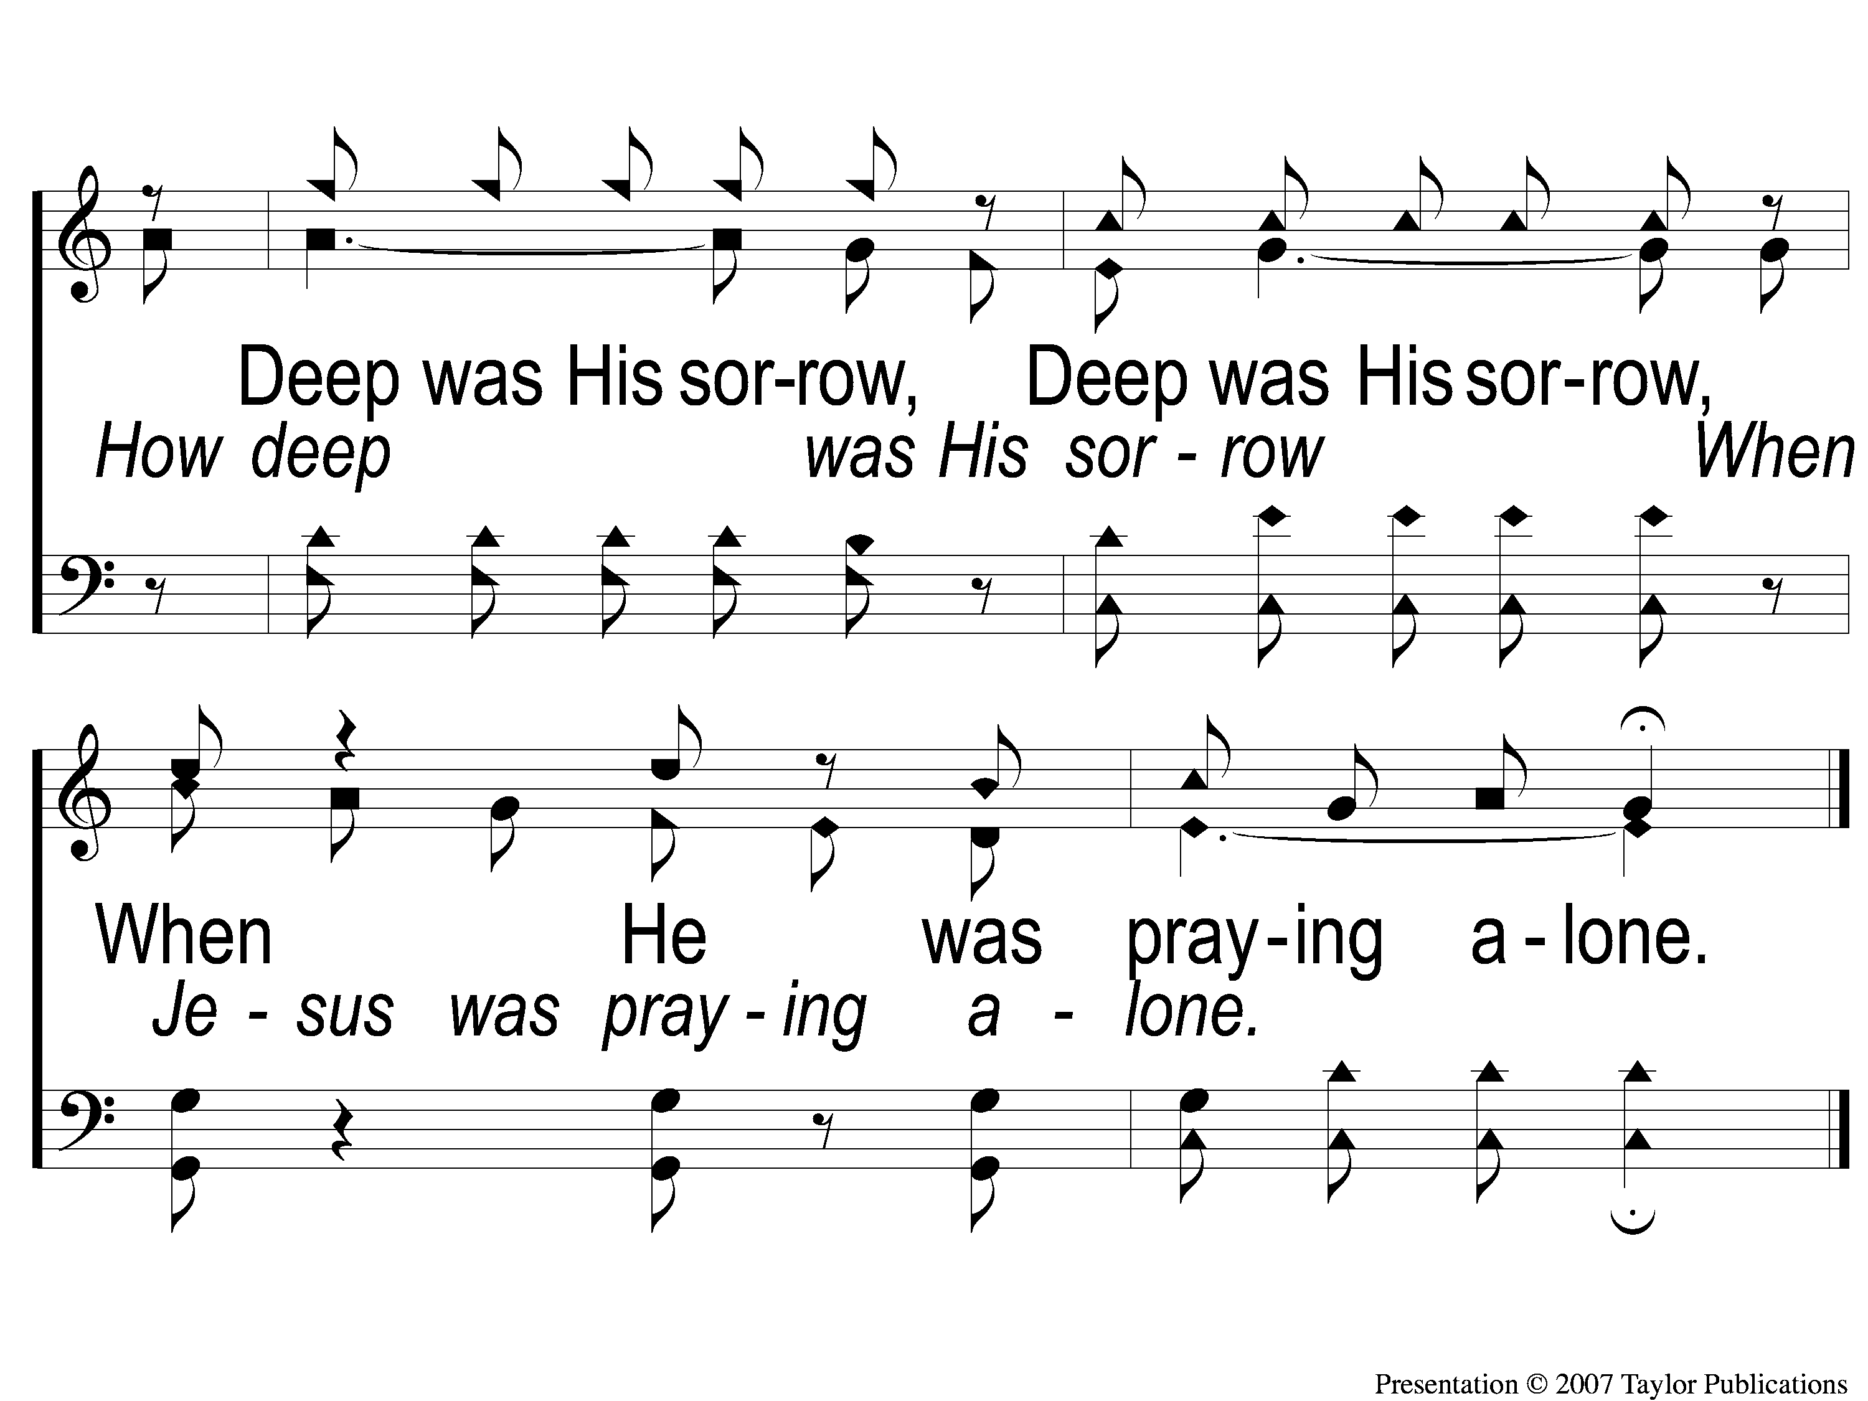
C-4 A Beautiful Prayer
A Beautiful Prayer
11

Slide 7
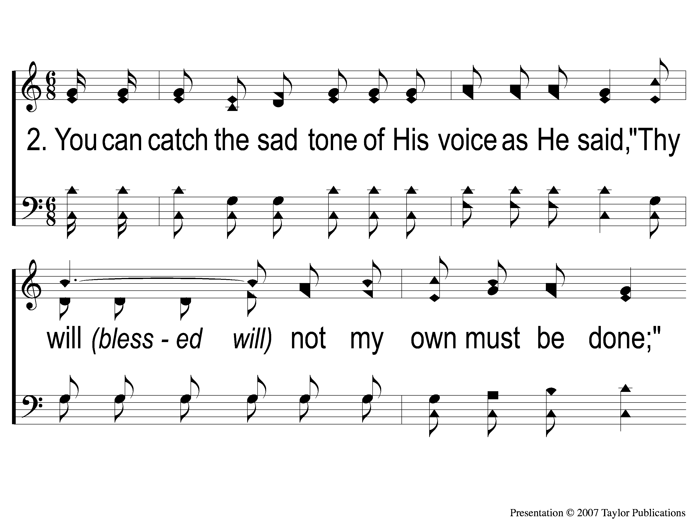
2-1 A Beautiful Prayer
A Beautiful Prayer
11

Slide 8
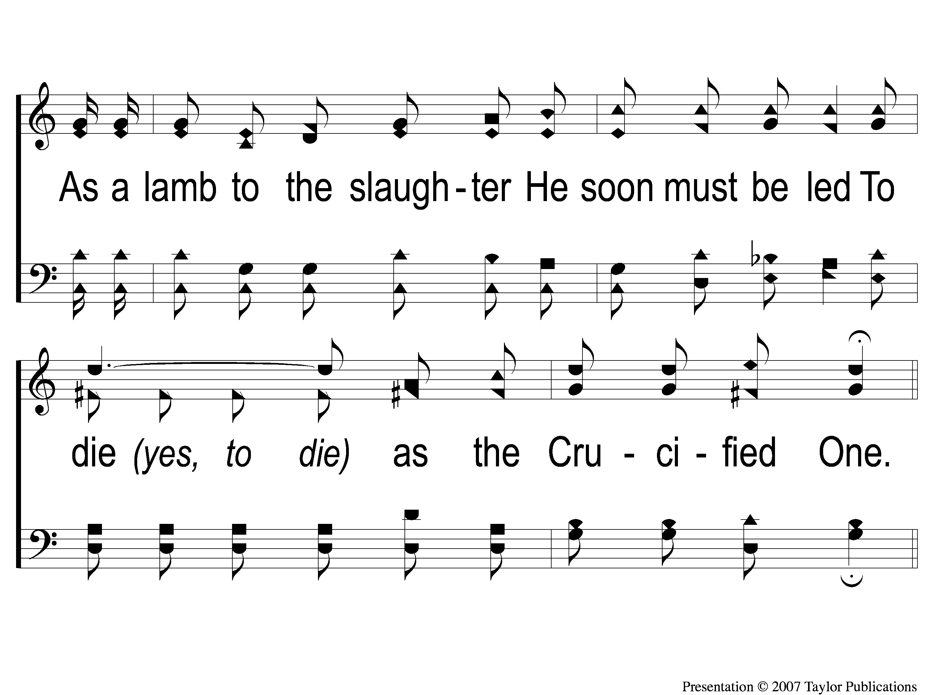
2-2 A Beautiful Prayer
A Beautiful Prayer
11

Slide 9
C-1 A Beautiful Prayer
A Beautiful Prayer
11

Slide 10
C-2 A Beautiful Prayer
A Beautiful Prayer
11

Slide 11
C-3 A Beautiful Prayer
A Beautiful Prayer
11

Slide 12
C-4 A Beautiful Prayer
A Beautiful Prayer
11

Slide 13
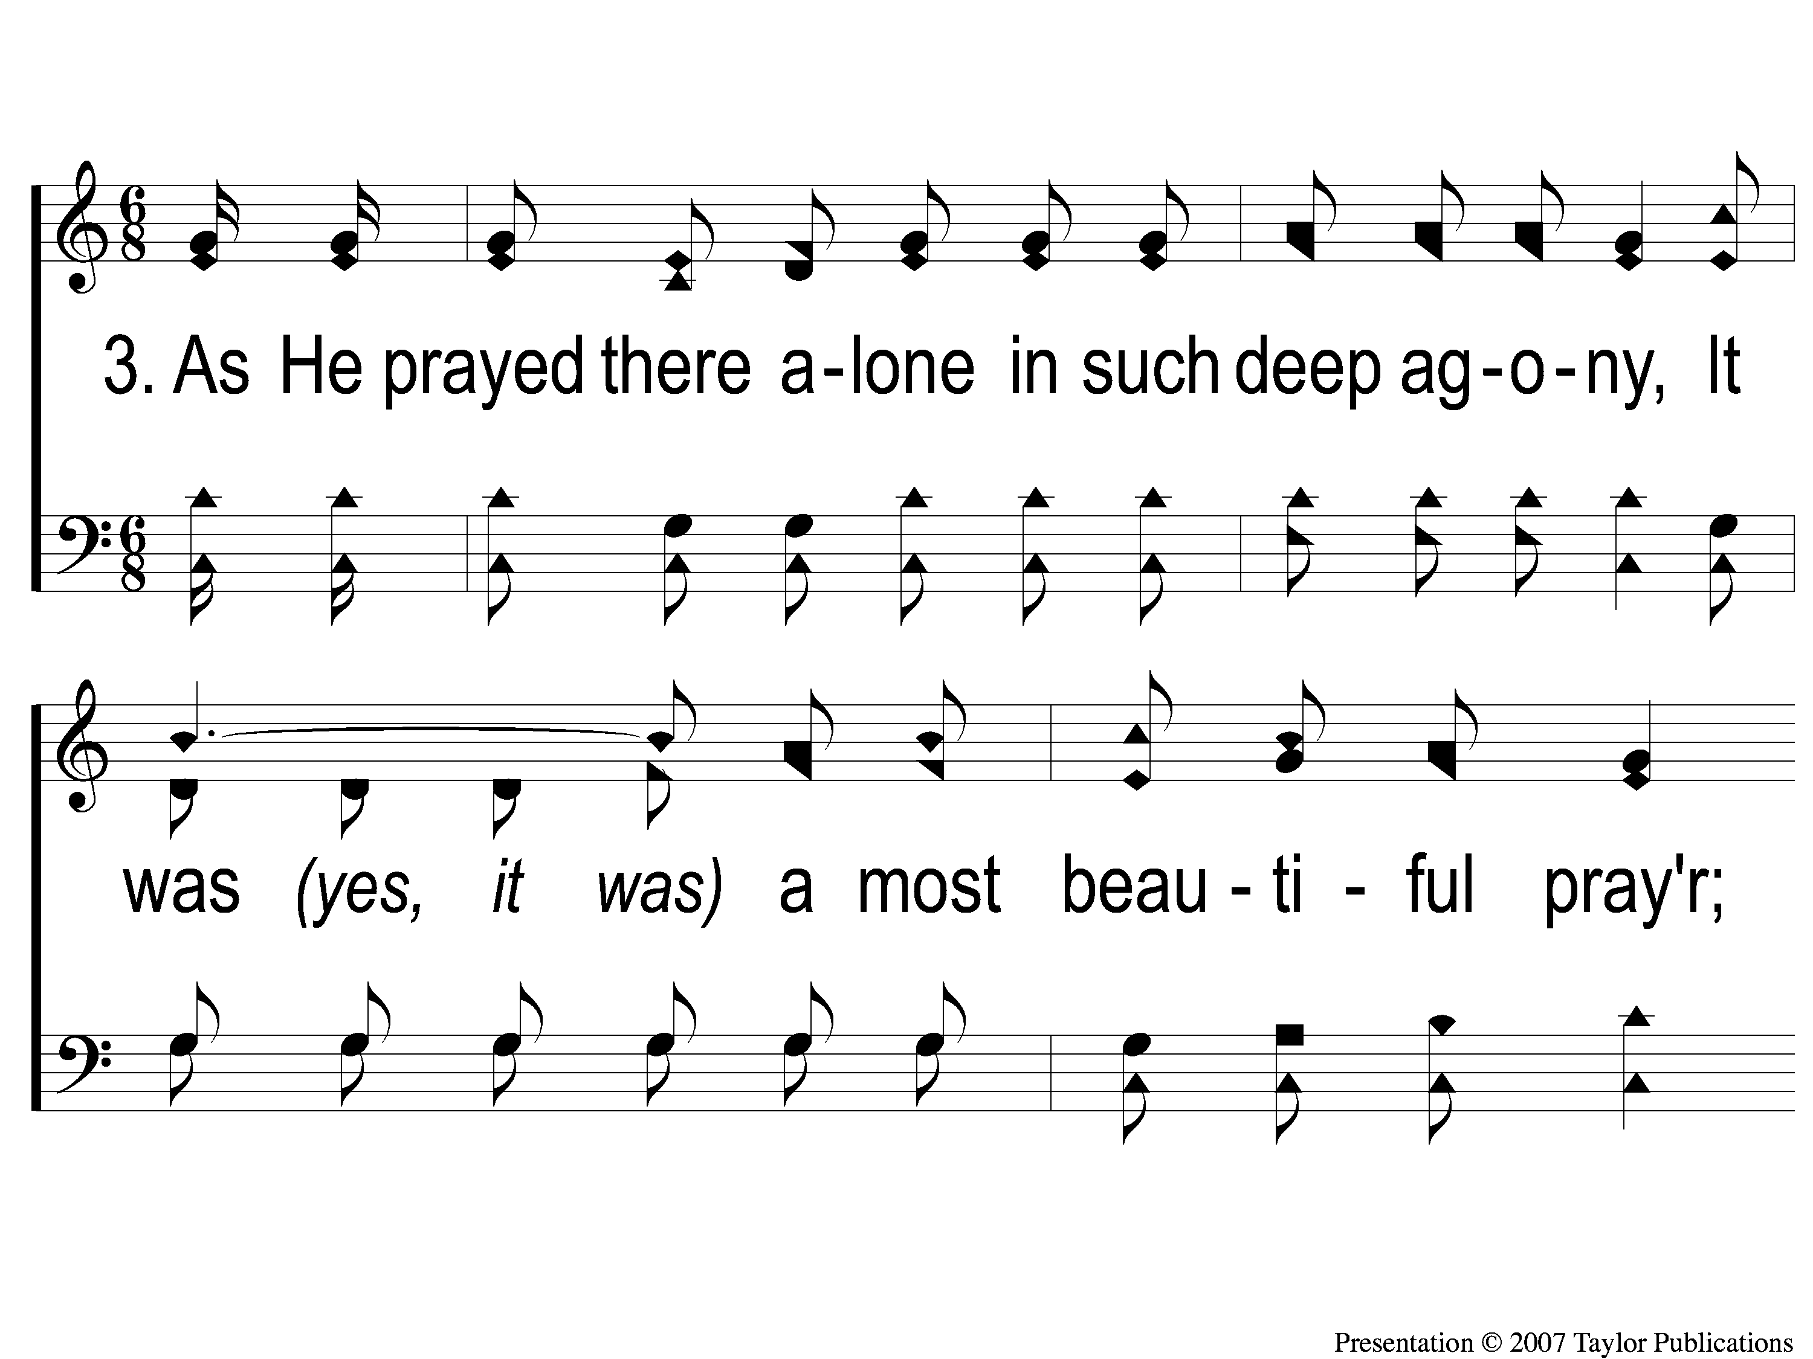
3-1 A Beautiful Prayer
A Beautiful Prayer
11

Slide 14
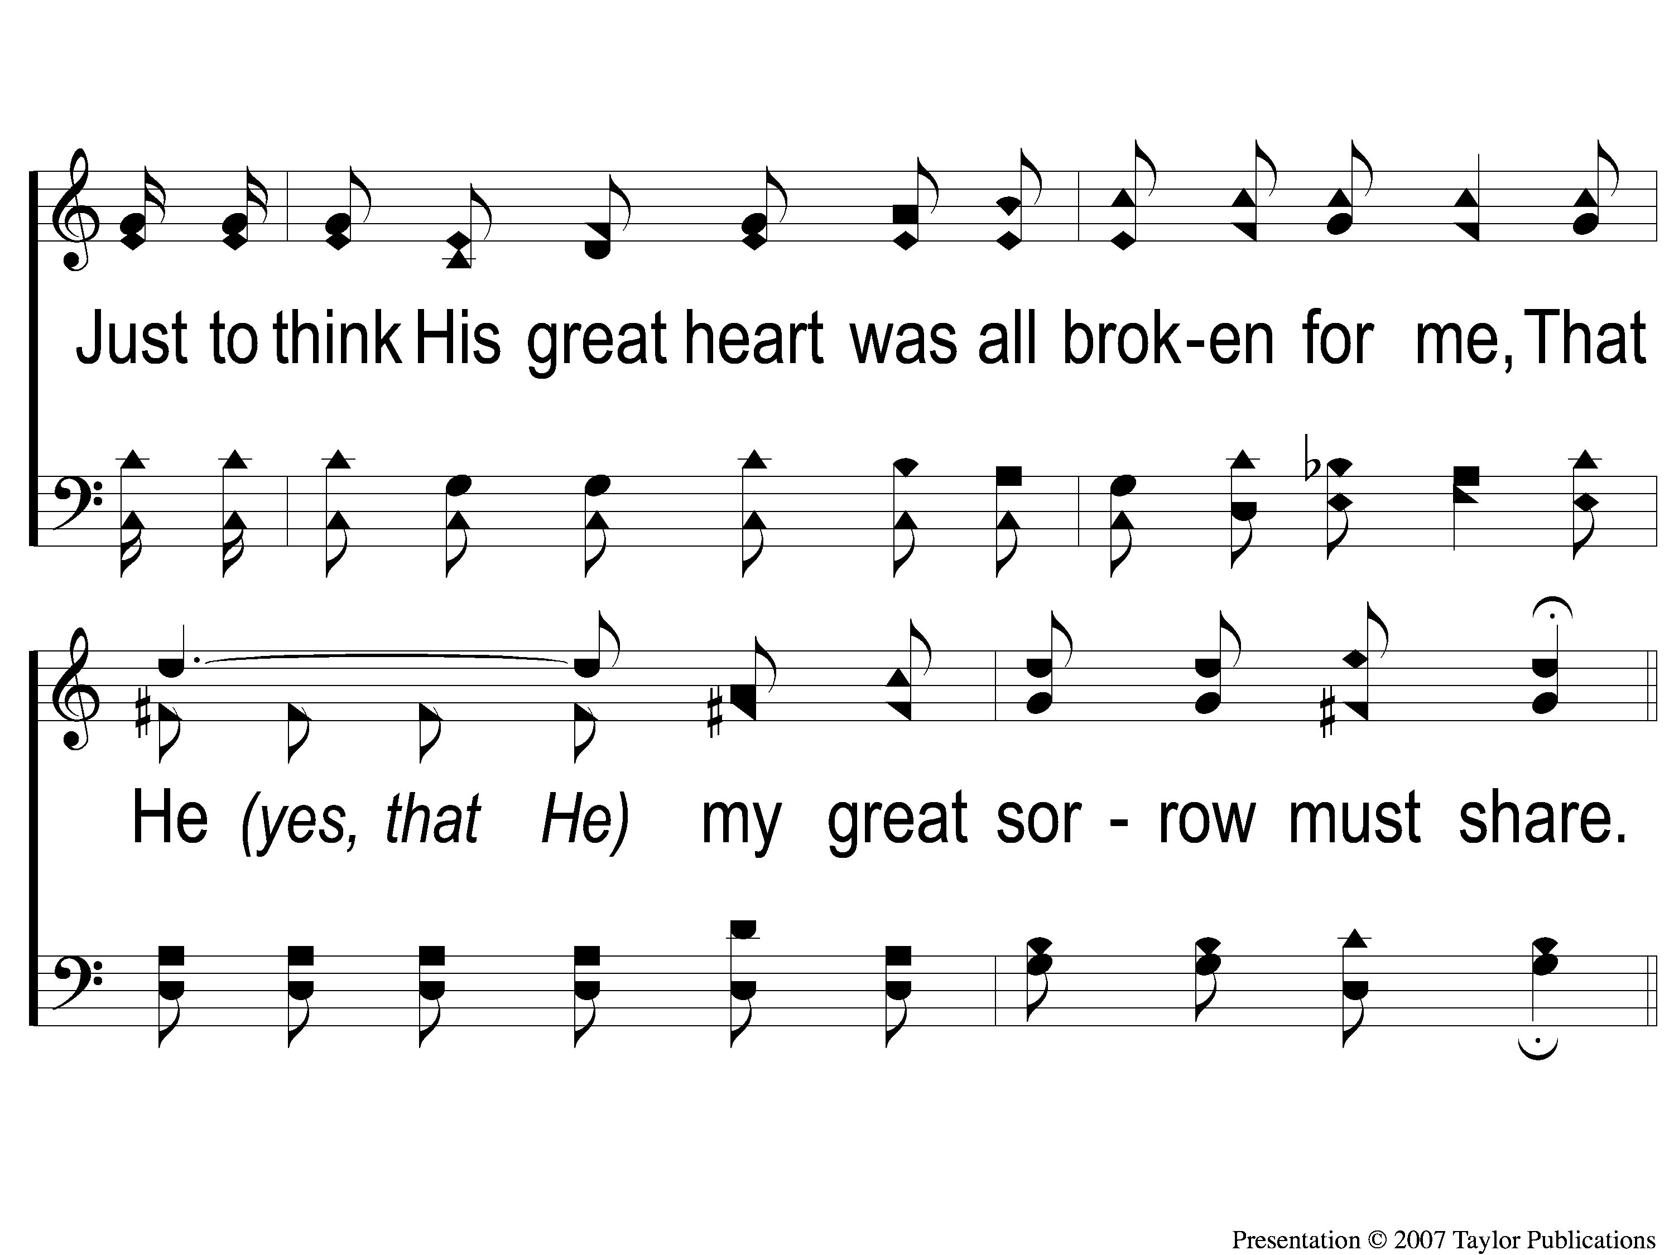
3-2 A Beautiful Prayer
A Beautiful Prayer
11

Slide 15
C-1 A Beautiful Prayer
A Beautiful Prayer
11

Slide 16
C-2 A Beautiful Prayer
A Beautiful Prayer
11

Slide 17
C-3 A Beautiful Prayer
A Beautiful Prayer
11

Slide 18
C-4 A Beautiful Prayer
A Beautiful Prayer
11

